Slide 1
Inheritance
Day 4

Slide 2
Inheritance in Java
It is the mechanism in Java by which one class is allowed to inherit the features(fields and methods) of another class. In Java, Inheritance means creating new classes based on existing ones. A class that inherits from another class can reuse the methods and fields of that class. In addition, you can add new fields and methods to your current class as well.

Slide 3
Inheritance
Super Class/Parent Class: The class whose features are inherited is known as a superclass(or a base class or a parent class).
Sub Class/Child Class: The class that inherits the other class is known as a subclass(or a derived class, extended class, or child class). The subclass can add its own fields and methods in addition to the superclass fields and methods.
Reusability: Inheritance supports the concept of “reusability”, i.e. when we want to create a new class and there is already a class that includes some of the code that we want, we can derive our new class from the existing class. By doing this, we are reusing the fields and methods of the existing class.

Slide 4
Types
Single Inheritance
Multilevel Inheritance
Hierarchical Inheritance
Hybrid Inheritance

Slide 5

Single Inheritance
In single inheritance, subclasses inherit the features of one superclass. In the image below, class A serves as a base class for the derived class B.

Slide 6
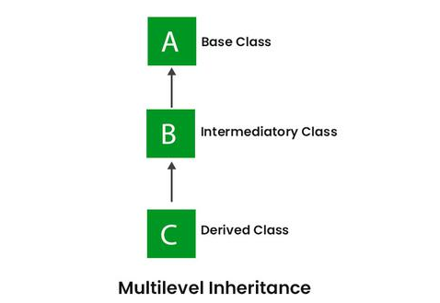
Multilevel Inheritance
In Multilevel Inheritance, a derived class will be inheriting a base class, and as well as the derived class also acts as the base class for other classes.

Slide 7
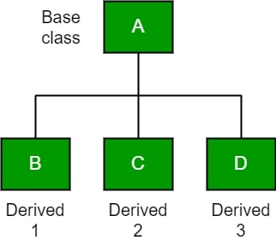
Hierarchical Inheritance
In Hierarchical Inheritance, one class serves as a superclass (base class) for more than one subclass. In the below image, class A serves as a base class for the derived classes B, C, and D.

Slide 8
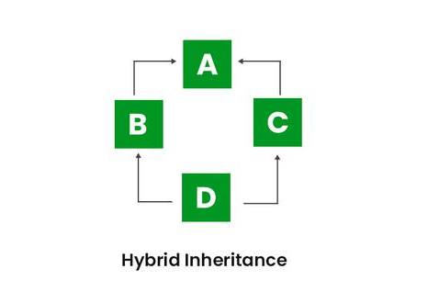
Hybrid Inheritance
It is a mix of two or more of the above types of inheritance. Since Java doesn’t support multiple inheritances with classes, hybrid inheritance involving multiple inheritance is also not possible with classes. In Java, we can achieve hybrid inheritance only through Interfaces if we want to involve multiple inheritance to implement Hybrid inheritance.

